Slide 1

LAD Presentation
Topic: Linear Equations and Vector Spaces
By Reneeka Nadkarni - C034

Slide 2
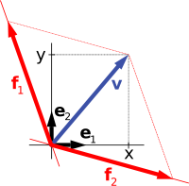
Importance
A vector space or a linear space is a group of objects called vectors, added collectively and multiplied by numbers, called scalars.
Real vector space and complex vector space terms are used to define these scalars as real or complex numbers.
Linear vector spaces play an important role in various fields including computer science, few applications include;
Image processing
Machine Learning
Cryptography
Computer Graphics
Natural Language Processing
Robotics etc

Slide 3
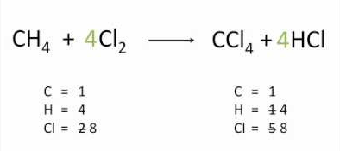
Application 1 Chemical Equations
Balancing chemical equations is a basic matter of chemistry, if not one of its most important issues, and it plays a main role in its foundation. In fact, balancing chemical equations is not chemistry; it is just linear algebra. However, it is quite important FOR chemistry.

Slide 4

Balancing Chemical Equations
In balancing a chemical equation, we need to determine the number of molecules of reactant that form the number of molecules of product, while maintaining an equal number of each type of atom on both sides of the equation.
Let’s rewrite this equation with unknown coefficients multiplying each molecule.
2. The problem now is to find values for x1,x2, x3 and x4 such that both sides of the equation contain the same number of atoms each of carbon, oxygen, and hydrogen.
3. Think of each of the molecules as a vector with three entries, of each number of atoms in the equation. Let’s say the first entry is of carbon atoms, the second of oxygen atoms, and the third of hydrogen atoms. Following vector represents C2H5OH.

Slide 5
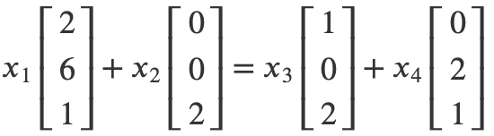
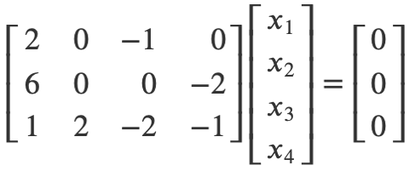
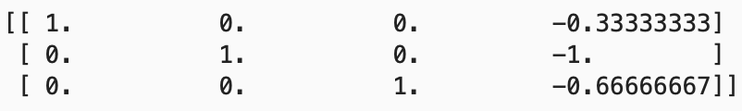
Balancing Chemical Equations
Equation:
Entire chemical equation expressed as a vector equation;
4. With unknowns on the left side, this vector equation represents a homogeneous system; which will be consistent and have solution.
5. Using RREF to find solutions

Slide 6
Balancing Chemical Equations
Equation:
6. For this application, we are specifically looking for positive integer solutions, so we will take x1=1, x2=3, x3=2, and x4= 3. Resulting new balanced equation;

Slide 7
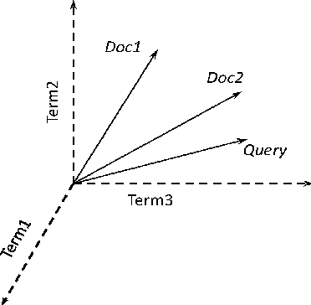
Application 2 Information Retrieval
Obtains relevant information from a collection of informational resources without returning information restricted to a single object collection but matching several that vary in the relevancy to the query. Various data structures and procedures can be used to increase speed of the searches and better handling of data.

Slide 8
Information retrieval
In information retrieval a vector space model represents documents in a database as vectors in ℝ^𝑛. Algorithms which aim to search the database for documents that are most relevant to keyword searches can then make use of the vector representation.
1. Create a list of n words that will be searchable in the database. This list could be a list of each distinct word in the whole collection of documents, disqualifying common words as keywords since they appear abundantly in all documents (the, as, in, it, etc.)
Eg: keywords for webpage content on info retrieval- {algorithm, engine, information, google, computations, matrix, optimization, retrieval, search, theory }
2. Each document in the database can now be represented by a vector in ℝ^𝑛, with the nth entry set to, 1 if the corresponding keyword appears in the document, otherwise 0.
3. Each webpage in the database is a vector in ℝ^10, with entries corresponding to these words. It is most convenient to write these vectors as 1×10 row vectors. Our database then is represented by a 𝑛×10 matrix that has a row for each title.

Slide 9
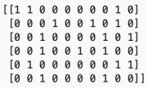
Information retrieval
4. Suppose we have 6 titles;
- Search Engine Algorithms
- How Google Search Optimization Works
- Information Retrieval Theory
- Matrix Models of Information Retrieval
- Theory Behind Search Engines
- Computations in Information Retrieval
Here, Search Engine Algorithms would be represented as [1,1,0,0,0,0,0,0,1,0]. We build a vector for each title, and then assemble them into a matrix 𝐷.

Slide 10

Information retrieval
5. Suppose we want to search for entries matching the words “information”, “retrieval”, and “theory”. We can build a 10×1 query vector, 𝑋 that has entries of 1 corresponding to these keywords. The query vector is [0,0,1,0,0,0,0,1,0,1]^T.
6. Matrix-vector product 𝐷𝑋 will now contain entries that represent the number of words from the search that match each title in the database
7. The third entry of D𝑋 is the largest, which means that the third webpage in the database best matches the list of keywords in the search. The last three titles indicate partial search matches.

Slide 11

R
E
S
O
U
R
C
E
S
https://bvanderlei.github.io/jupyter-guide-to-linear-algebra/Applications_VS.html
http://mit.imt.si/izvodi/mit104/risteski.pdf
https://byjus.com/maths/vector-space/
https://www.quora.com/What-are-some-real-life-applications-of-linear-vector-spaces-or-matrices
https://www.quora.com/What-is-the-importance-of-an-information-retrieval-system-to-the-way-a-computer-works

